Slide 1
Team_5: Health Care
Anticipating Heart Diseases

Slide 2
Analysis Report of Heart Disease
Team members: Lauren Carter, Isaac Fonseca, Sandeep Singh and Warren Simmons
Introduction:
This report presents an analysis of mortality rates for heart disease and stroke. The data set contains the data of 9
years ranging from 2010 to 2019 from Autuage County, Alabama, and several other counties. The purpose of this
report is to explore trends, patterns and outliers in mortality rates across different causes of death, demographic
groups, and years. The data set has different features such as age group, sex, location, state, county, mortality rate,
confLow, confHigh, and year. The data set contains information on mortality rates for different causes of death that
may includes:
■ All heart disease
■ All stroke
■ Coronary heart disease
■ Cardiovascular disease
■ Heart failure

Slide 3
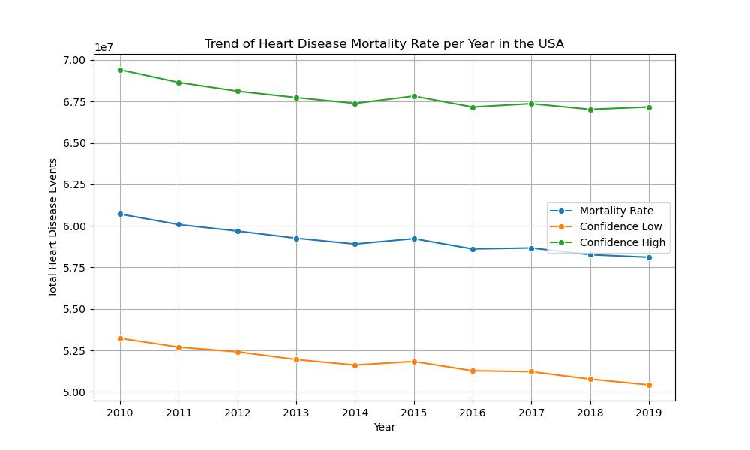
Trend of Heart Disease Mortality Rate per Year in the USA
XYZ
XYX
XYZ

Slide 4
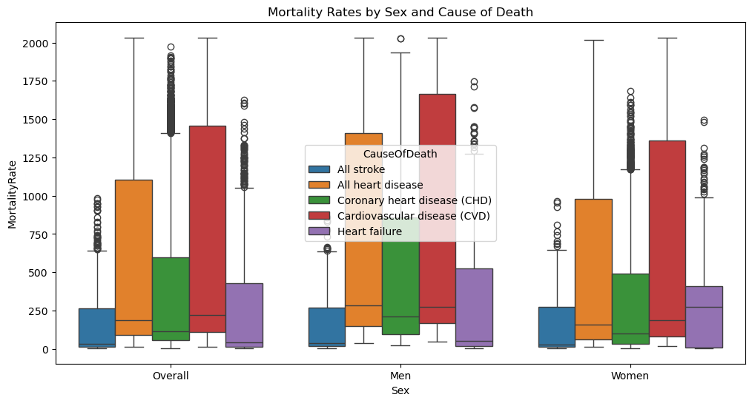
Mortality Rates by Sex and Cause of Death
XYZ
XYX
XYZ

Slide 5
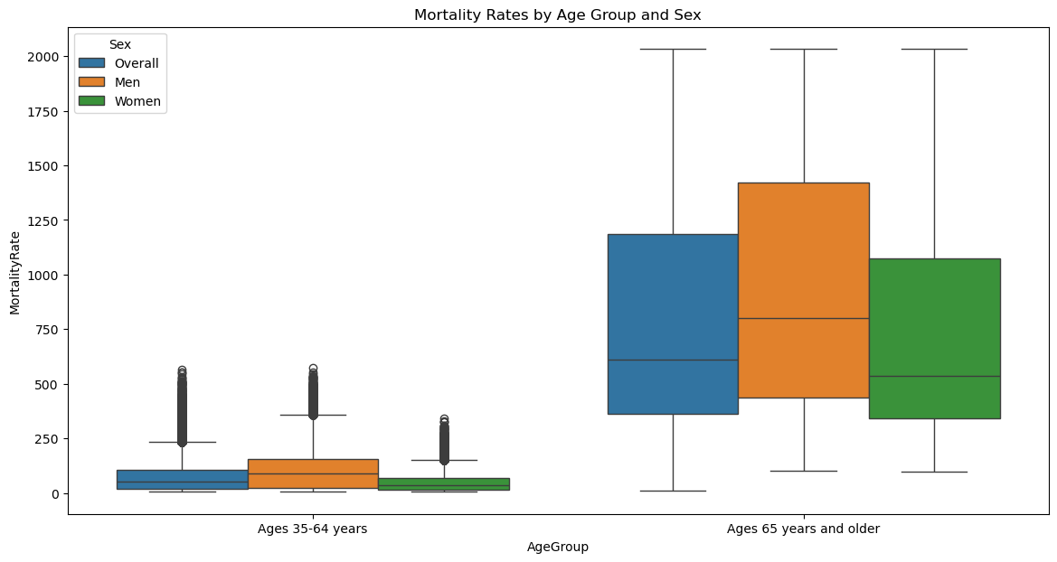
Monthly Rates by Age Group and Sex
XYZ
XYX
XYZ

Slide 6
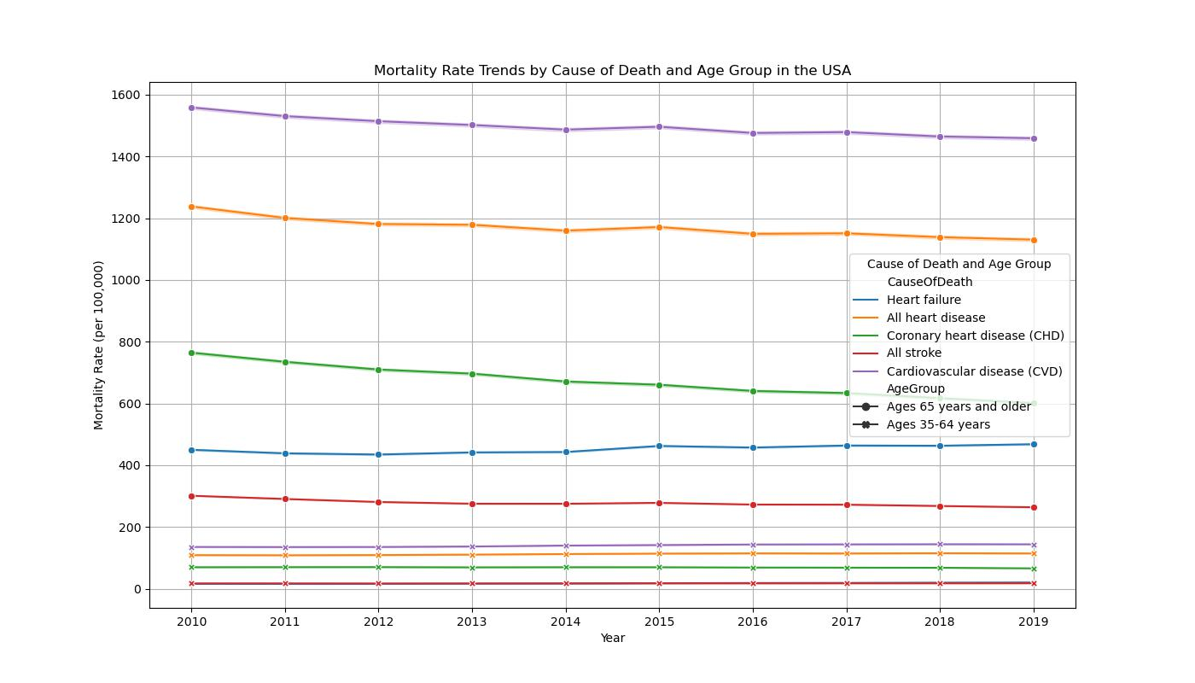
Mortality Rate Trends by Death and Age group in the USA
XYZ
XYX
XYZ

Slide 7
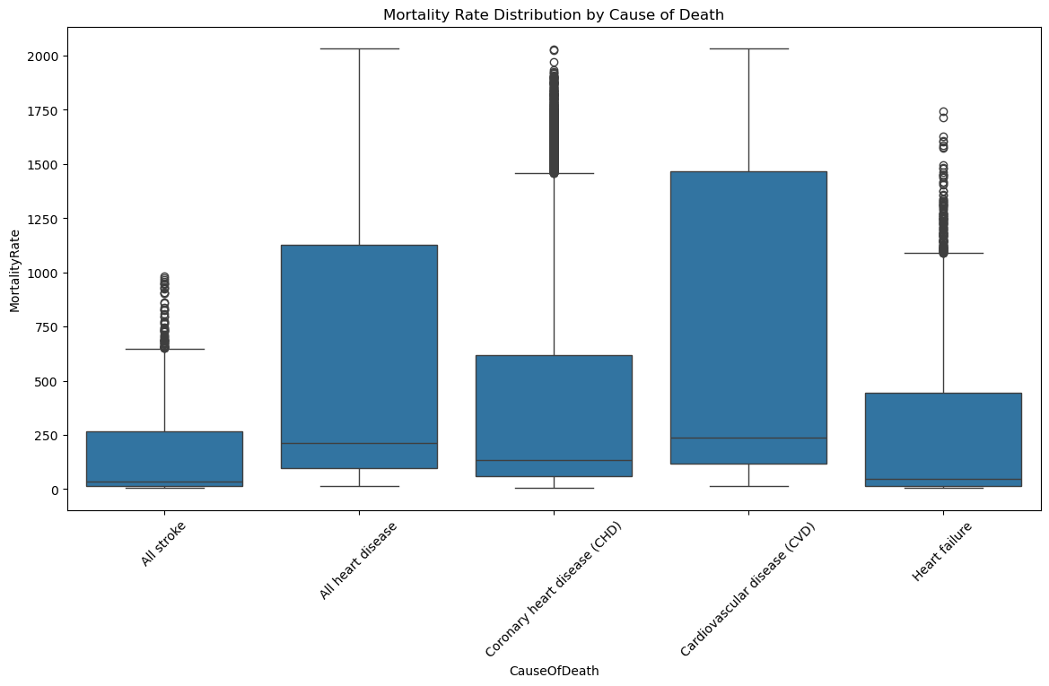
Mortality Rate Distribution by Cause of Death
XYZ
XYX
XYZ

Slide 8
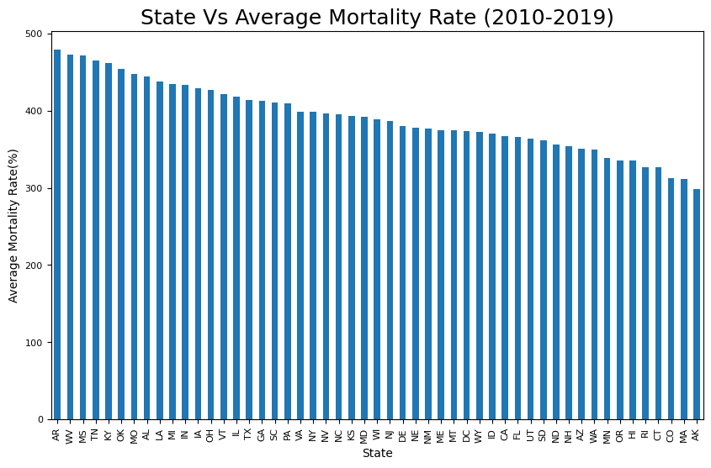
State Vs Average Mortality Rate (2010-2019)
XYZ
XYX
XYZ

Slide 9
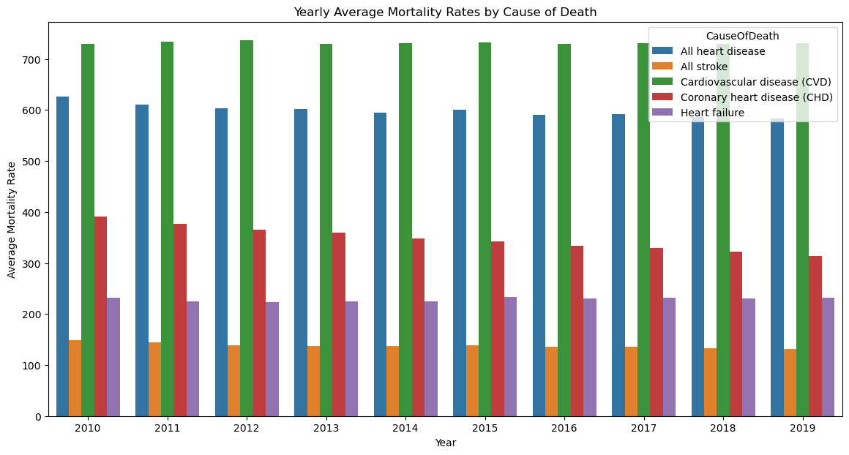
Yearly Average Mortality Rates b Cause of Death
XYZ
XYX
XYZ

Slide 10
Executive Summary
Anticipating Heart Diseases
Historical trend
Current trend
Conclusion:The trend analysis of mortality rates for heart disease, stroke, and related conditions reveals an overall decline in mortality rates for most conditions, with significant variability.
Gender differences show a higher mortality rates for men compared to women, with notable declines for both groups. While other conditions show positive trends, the overall category of Cardiovascular Disease, remains a major health concern in the future.

